Slide 1


{Title – 3 lines Max}
{Part #} {SubTitle}
{Author}
{M####}

Slide 2
Agenda
Best Practices
{Topic}
{Topic}

Slide 3
Best Practices
Section 1

Slide 4
Best Practices Overview
When doing presentations for MERG (or anywhere else) there are certain best practices which if followed will make for a better presentation and user experience.
These best practices are not rules, they are more like gentle reminders.
Under some circumstances it may be perfectly fine to deviate from the best practices as long as it is done with consideration of the consequences.

Slide 5
Best Practices Overview
Know your purpose. Are you teaching something? Selling something? Trying to convince someone? Each requires a different approach.
Know your audience. A presentation for a MERG special interest group will be different from one designed for a general walk up audience at a hobby show.
Know your venue. A presentation designed as a handout will differ from one designed for presenting as a speech (live or Zoom meeting).
Know your material. It almost goes without saying that you should know what it is you are presenting. Sometimes however you could be acting as a facilitator to debate amongst several options. Do not be confused – the topic in that case is the decision making process itself – not the actual technical content.
Organize your thoughts. Start by making the case for why the listener should continue listening. Build your story gradually without smacking your audience.
Stick to the subject. There may be a lot of rabbit holes to go down but resist the temptation to go down them.
Consider human factors. Specifically concepts like:
  Consistency, Predictability, Empathy, & Respect (more on these on the next page)

Slide 6
Human Factors
There are certain human factors concepts if considered can make a presentation much better than it otherwise would have been.
Consistency – The way our brains work is by categorizing information into buckets using past knowledge as filing criteria. The implication is this: To help your audience comprehend strive to be consistent with your visual style, choice of words and spelling. Be mindful of cultural norms that could impact how people file information away in their mind.
Predictability – One of the fascinating traits of the way we think is using current knowledge to predict future events. We can use this trait in our presentations by being predictable in our style and delivery (NOT random!)
Empathy – Imagine yourself in the audience. What would they hear and see and is the message both logical and compelling. Be considerate of and consider a 5 minute ‘comfort break’ every hour or so at a logical pause point.
Respect – We are not robots. In spite of our best efforts sometimes the information sent is not what was received. It is always a good idea to respect your audience and Never assume they are just ‘slow’. Take a moment to understand where the message might have been distorted (or lost). This does not mean you need to address it then and there but at least you can come back to it.

Slide 7

PowerPoint Specifics
Use a Template – to give a consistent visual style. (Many free templates are on line with Microsoft and elsewhere.)
Create a Table of Contents (ToC). Plan out what is coming next!
For each item in the ToC create a ‘New Section Slide’ with exactly the same wording and section numbers as was used in the ToC.
Optionally a line in the ToC can be hyperlinked directly to that section.
When presenting do not use ‘Normal’ view (used for creating only).
Use ‘Slide Show’ mode
Better yet is ‘Presenters Mode’ (in slide show right click and select it)
Practice and be familiar with moving forward and backward in the slide deck as needed.
Animations add visual interest and can help convey the message however they can easily be overused and detract rather than enhance.

Slide 8
Best Practices Recap
There is no absolutely right or wrong way however there are some best practices which if followed can improve any presentation.

Slide 9
Topic Overview
Overview of {Topic} goes here
Draw your audience in without hitting them on the head

Slide 10
Topic Details as needed

Slide 11
Recap
Remind your Audience what you just covered

Slide 12
Questions?
Supporting Material Can Follow

Slide 13
Supporting Material
Not directly needed during presentation
Anticipate and Answer common Questions
Suggest What Comes Next
Provide Additional References

Slide 14
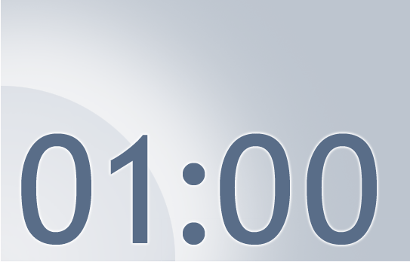
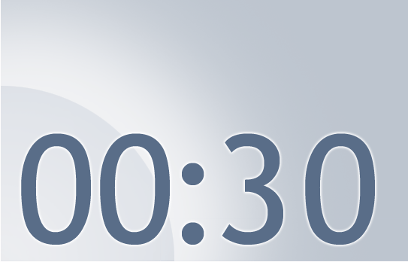
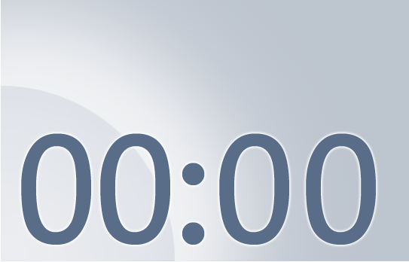


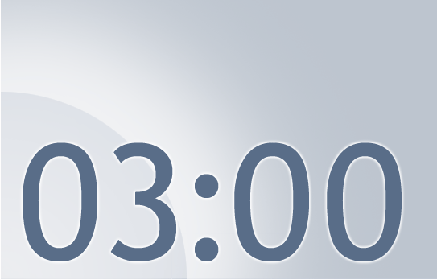

The Next Train Departs in:
Notes:
Using this PowerPoint break timer
This PowerPoint slide uses images, custom animation, and timing to provide a countdown timer that you can use in any presentation. When you open the template, you’ll notice that the timer is set at 00:00. However, when you start the slide show, the timer will start at the correct time and count down by 1-minute intervals until it gets to 1 minute. At that point, it will count down in two 30-seconds intervals to 00:00.

